Slide 1
Introduction to Computer Networks 22CS008
Data Link Layer
Lecture10-11 (Theory)
Dr. Htet Ne Oo
Department of Computer Science and Engineering,
Chitkara University, Punjab

Slide 2
Index
,
Redundancy
Error Detection
Error Correction

Slide 3
Redundancy
Instead of repeating the entire data stream, a shorter group of bits may be appended to the end of each unit.
This technique is called Redundancy because the extra bit are redundant to the information. They are discarded as soon as the accuracy of the transmission has been determined.

Slide 4
Types of Redundancy Checks
There are basically four types of redundancy checks.
1. VRC (Vertical Redundancy Check).
2. LRC (Longitudinal Redundancy Check).
3. CRC (Cyclical Redundancy Check).
4. Checksum

Slide 5
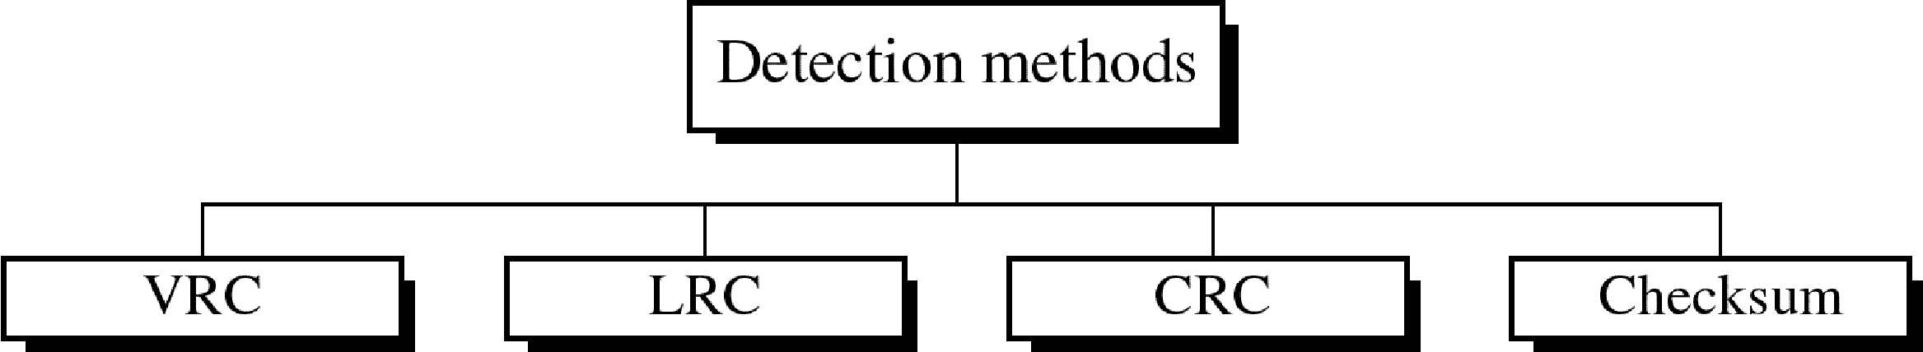
Four types of redundancy checks are used in data communications

Slide 6
Cyclic Redundancy Check
CRC Generation at sender side
Find the length of divisor ‘L’
(divisor is already agreed between sender and receiver)
Append ‘L-1’ bits to the original message
Perform binary division operation
Remainder of the division = CRC
Note: CRC must be of ‘L-1’ bits.
For binary division, XOR is used.

Slide 7
Cyclic Redundancy Check
CRC Verification at receiver side
Received original message appended with CRC
Perform binary division operation as in sender side
If the remainder is all ‘0’s, then the message is not corrupted during transmission

Slide 8
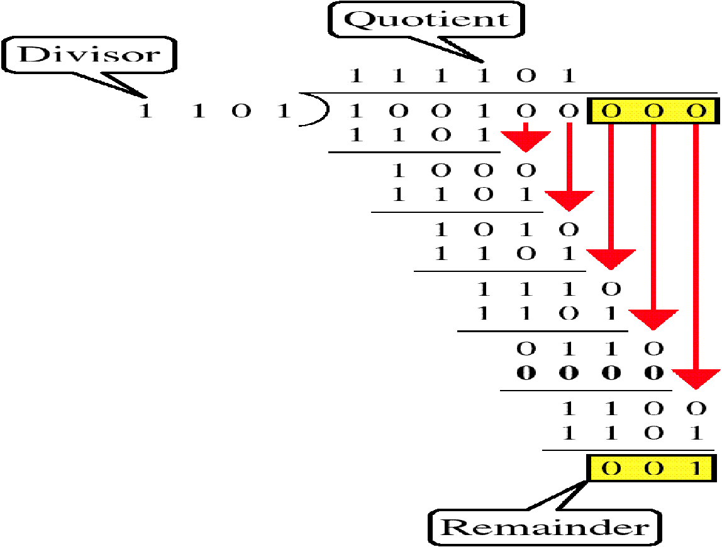
Binary Division

Slide 9
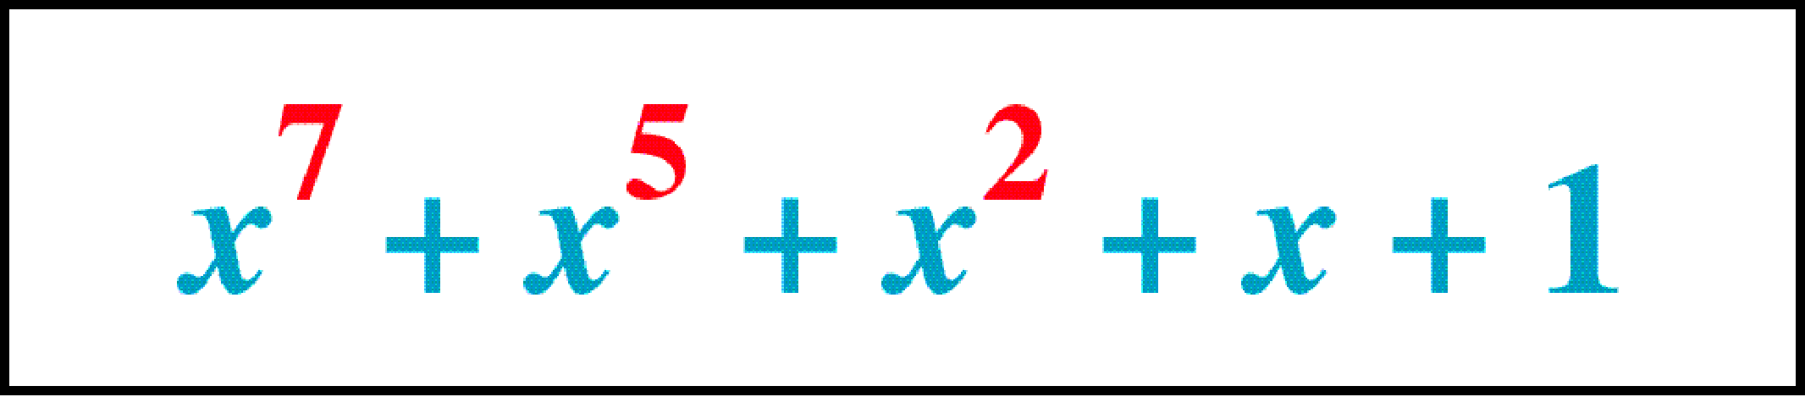
Polynomial
Sometimes, the divisor can be in the form of polynomial also.

Slide 10
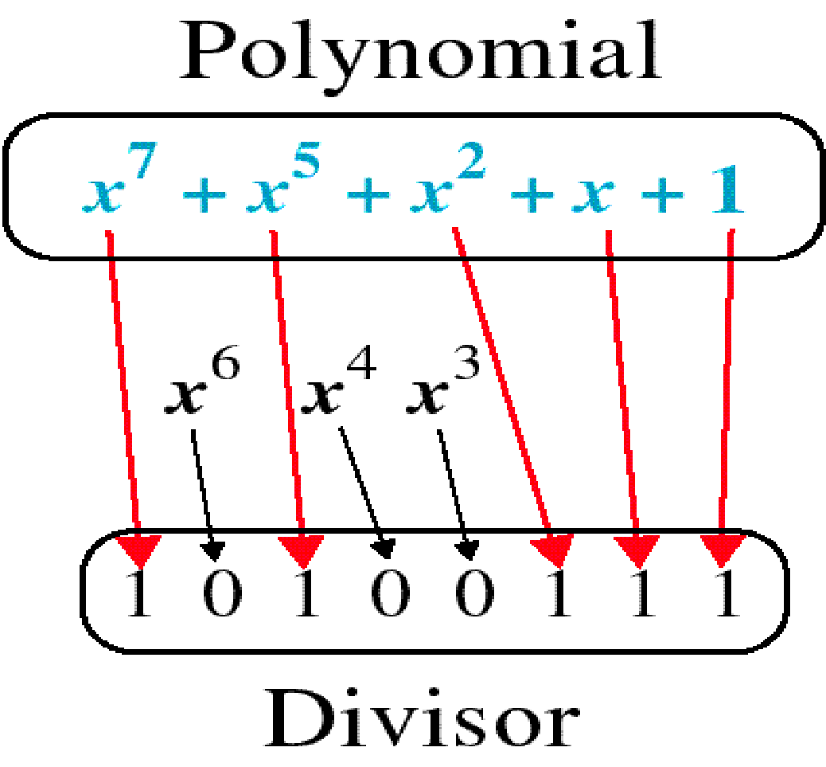
Polynomial and Divisor

Slide 11
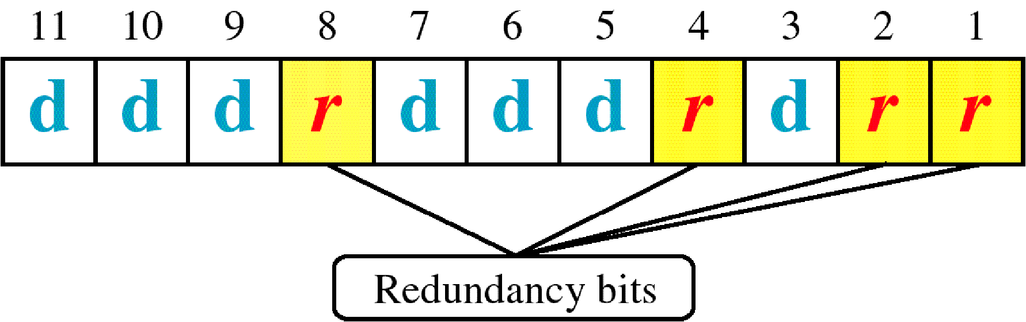
Hamming Code

Slide 12
Hamming Code Algorithm
General Algorithm of Hamming code: Hamming Code is simply the use of extra parity bits to allow the identification of an error.
Write the bit positions starting from 1 in binary form (1, 10, 11, 100, etc).
All the bit positions that are a power of 2 are marked as parity bits (1, 2, 4, 8, etc).
All the other bit positions are marked as data bits.

Slide 13
Hamming Code Algorithm
4. Each data bit is included in a unique set of parity bits, as determined its bit position in binary form.
a. Parity bit 1 covers all the bits positions whose binary representation includes a 1 in the least significant position (1, 3, 5, 7, 9, 11, etc).
b. Parity bit 2 covers all the bits positions whose binary representation includes a 1 in the second position from the least significant bit (2, 3, 6, 7, 10, 11, etc).
c. Parity bit 4 covers all the bits positions whose binary representation includes a 1 in the third position from the least significant bit (4–7, 12–15, 20–23, etc).

Slide 14
Hamming Code Algorithm
d. Parity bit 8 covers all the bits positions whose binary representation includes a 1 in the fourth position from the least significant bit bits (8–15, 24–31, 40–47, etc).
e. In general, each parity bit covers all bits where the bitwise AND of the parity position and the bit position is non-zero.

Slide 15
Hamming Code Algorithm
5. Since we check for even parity set a parity bit to 1 if the total number of ones in the positions it checks is odd.
6. Set a parity bit to 0 if the total number of ones in the positions it checks is even.

Slide 16
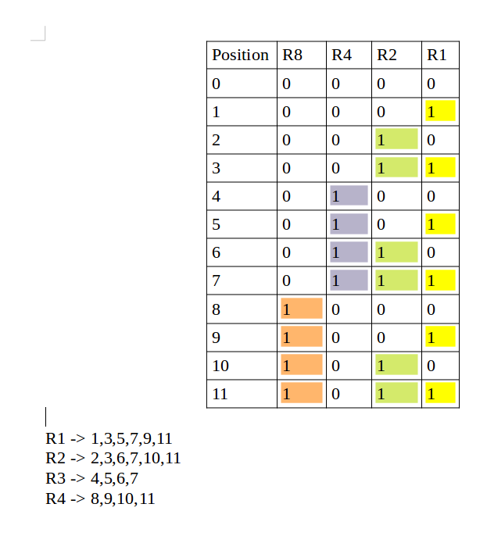
Hamming Code Algorithm

Slide 17
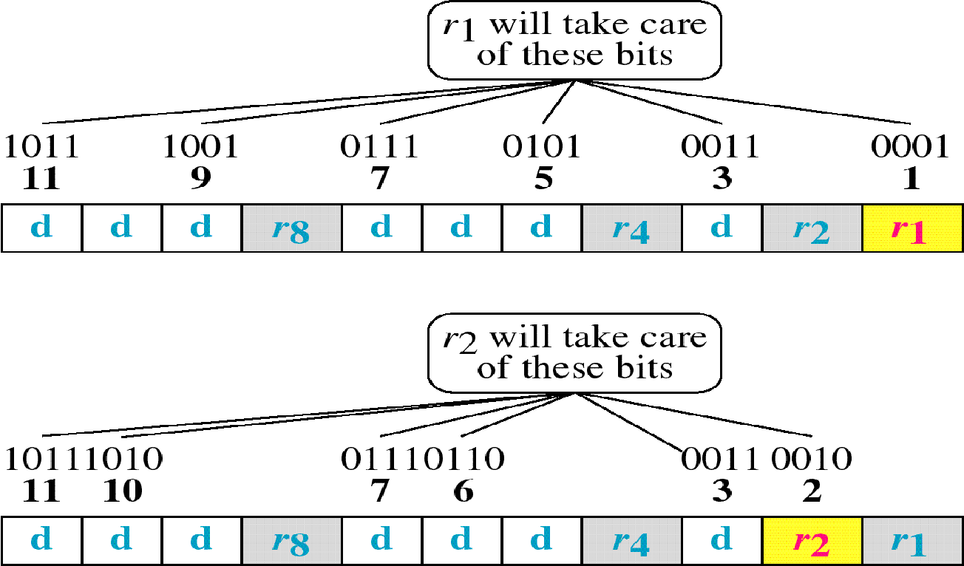
Hamming Code

Slide 18
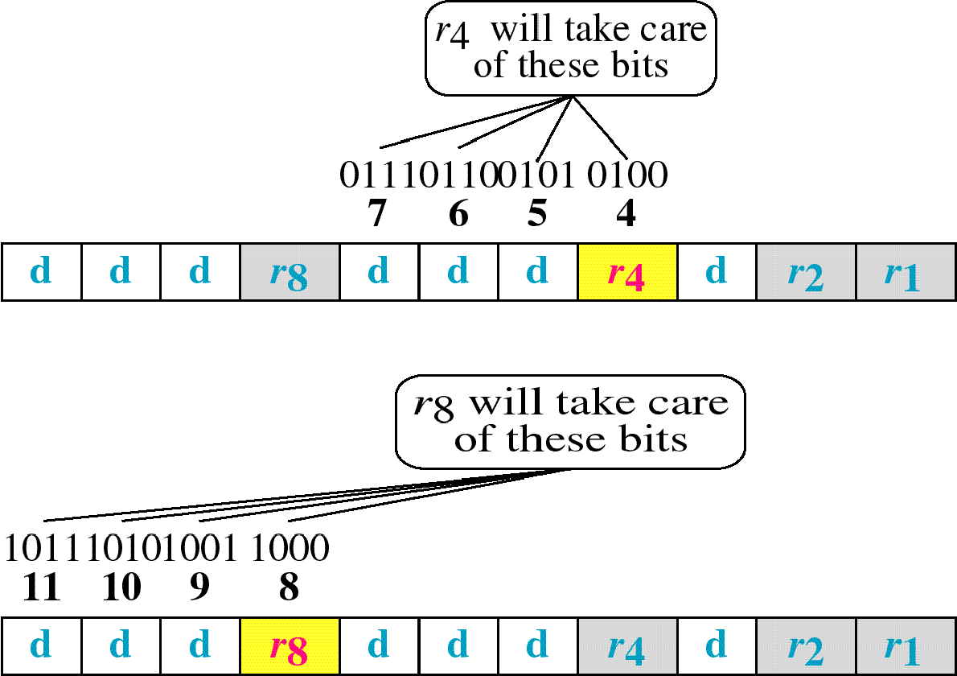
Hamming Code

Slide 19
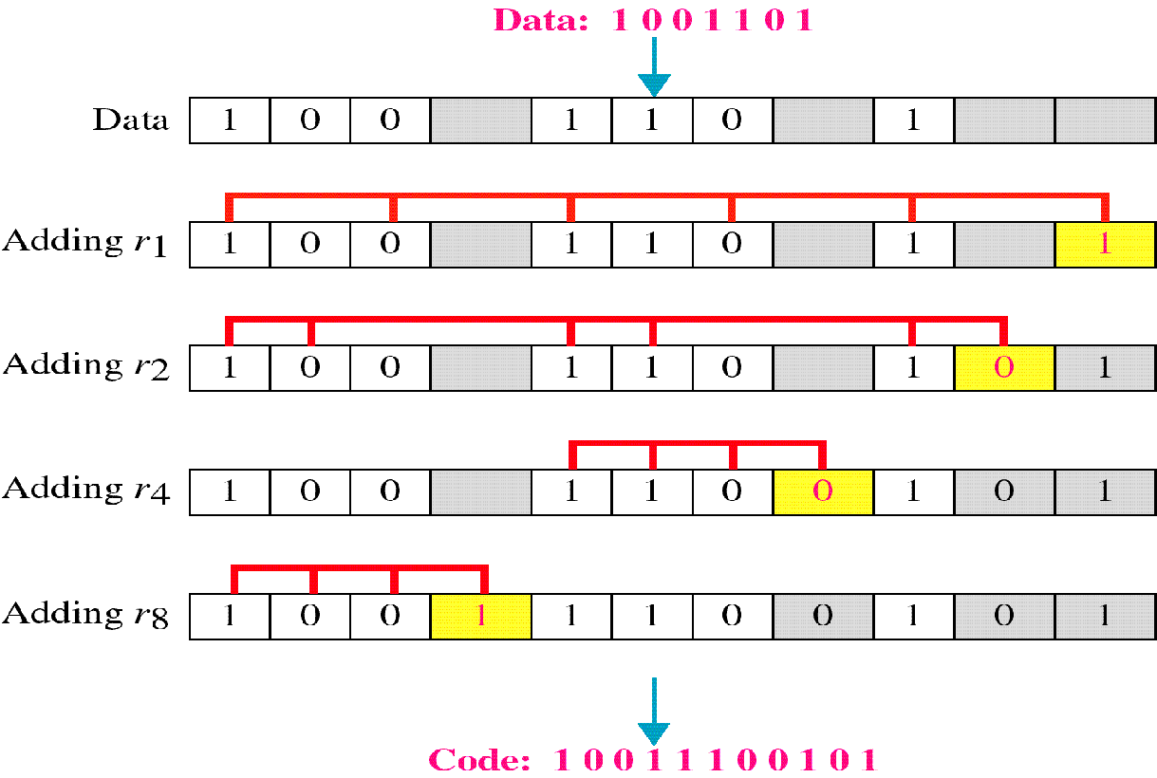
Example of Hamming Code

Slide 20
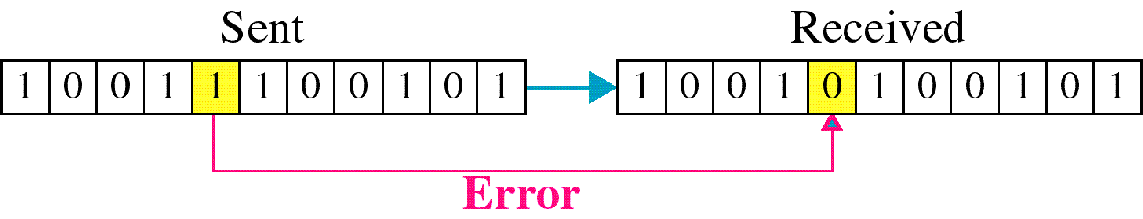
Single-bit error

Slide 21
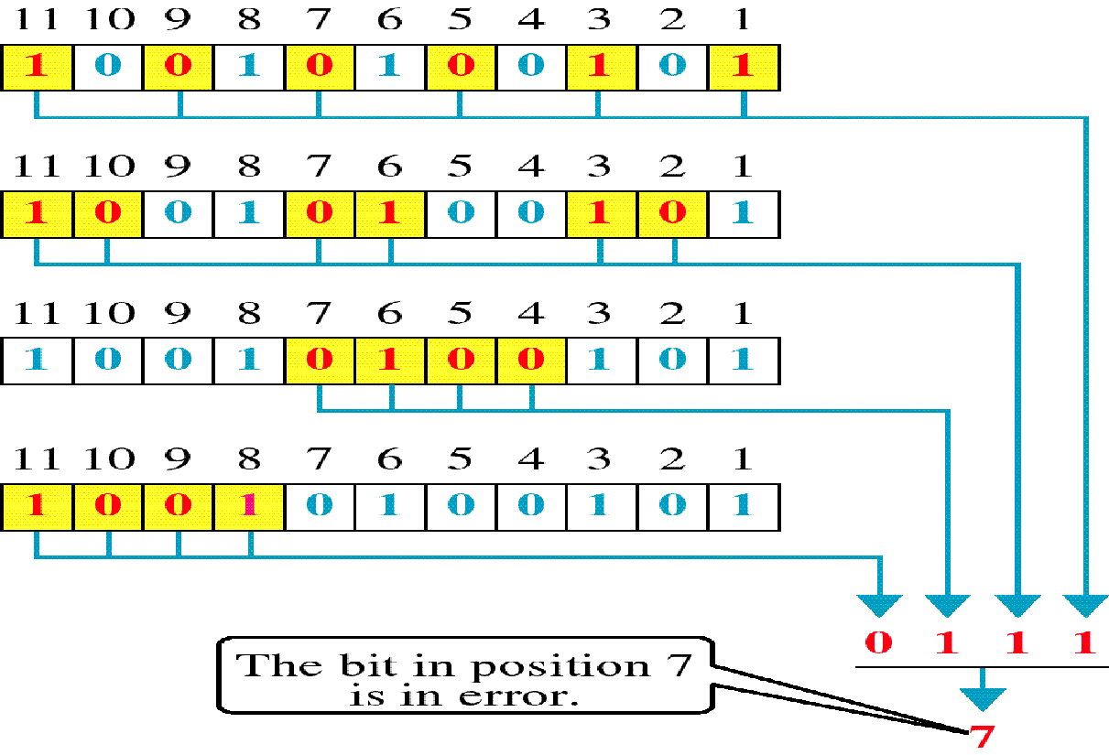
Error Detection

Slide 22
The minimum Hamming distance is the smallest Hamming distance between all possible pairs in a set of words.
Let us find the Hamming distance between two pairs of words.
1. The Hamming distance d(000, 011) is 2
2. The Hamming distance d(10101, 11110) is 3 because

Slide 23
Example
Find the minimum Hamming distance of the coding scheme in Table
Solution
We first find all Hamming distances.
The d_{min} in this case is 2.

Slide 24
Thank You

Slide 25
Break Time

Slide 26
Checksum
Checking the sum of data words
1. Divide the data streams into equal size blocks
2. Do binary addition of those blocks
3. If there is carry bit, add that carry bits also.
4. Do 1’s complement (Changing 1 to 0, or 0 to 1)
Bit stream
10110011 10101011 01011010 11010101
10110011
10101011
01011010
11010101
Receiver side, do the addition process including check sum result.
If all ‘1s’ the data error free and accepted. Else it will be discarded.

Slide 27
